Slide 1
BRICK game

Slide 2
GROUP MEMBERS
Maria Varghese – Roll no: 11
Rona Benny – Roll no: 37
Rosemole M Babu – Roll no: 38

Slide 3
abstract
This project aims to develop a brick game using HTML,CSS,JAVASCRIPT and PHP.
The data is stored using MySQL.
HTML is used to give basic mark-up to the project, CSS is used for styling , JAVASCRIPT is used to make the website dynamic and PHP is used for connecting to the database and storing data to the database (scores ,registrations ,usernames etc).

Slide 4
introduction
Brick game is used to provide entertainment and a good gaming experience to the users.
In the brick game, there will be a paddle that support the ball which can be moved left and right accordingly with the help of arrows and the ball when hitting enables points.
The user is also able to see the highest scores.

Slide 5
OUTPUT

Slide 6
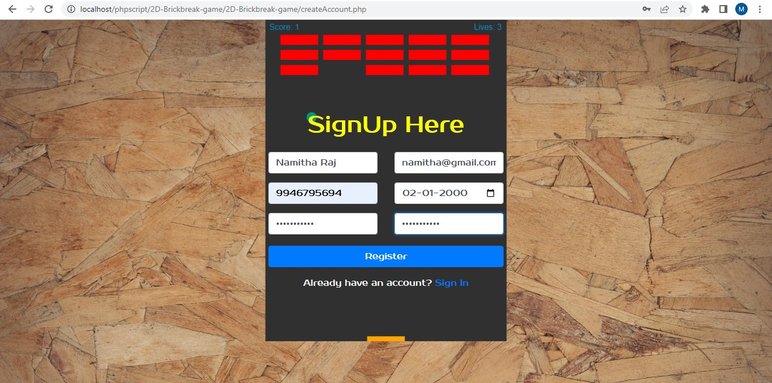
Registration page

Slide 7
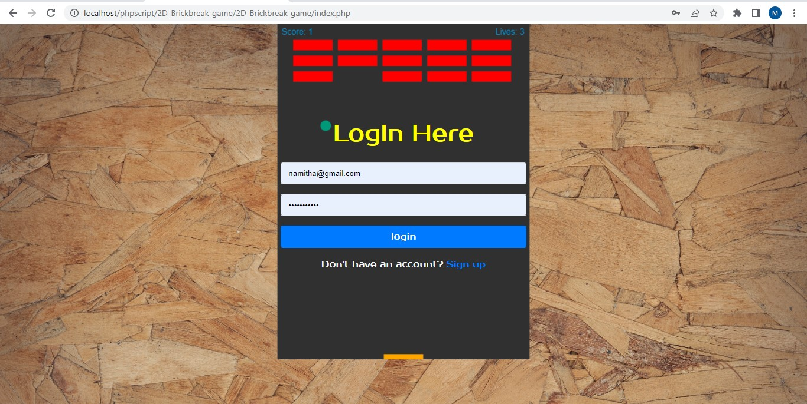
Login page

Slide 8
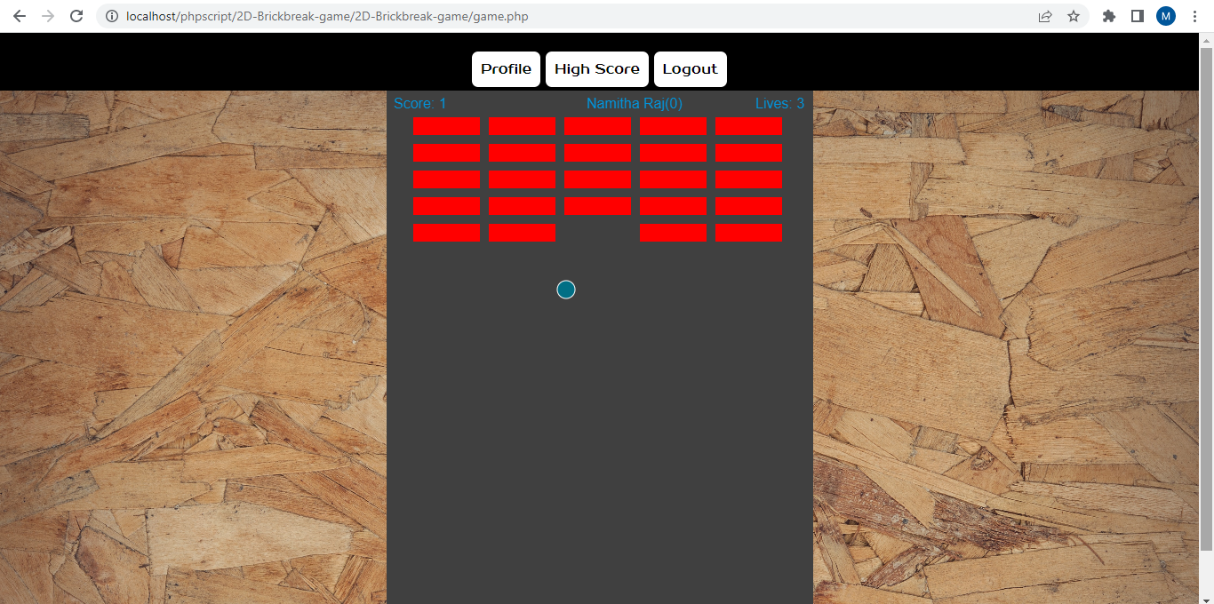
Brick game

Slide 9
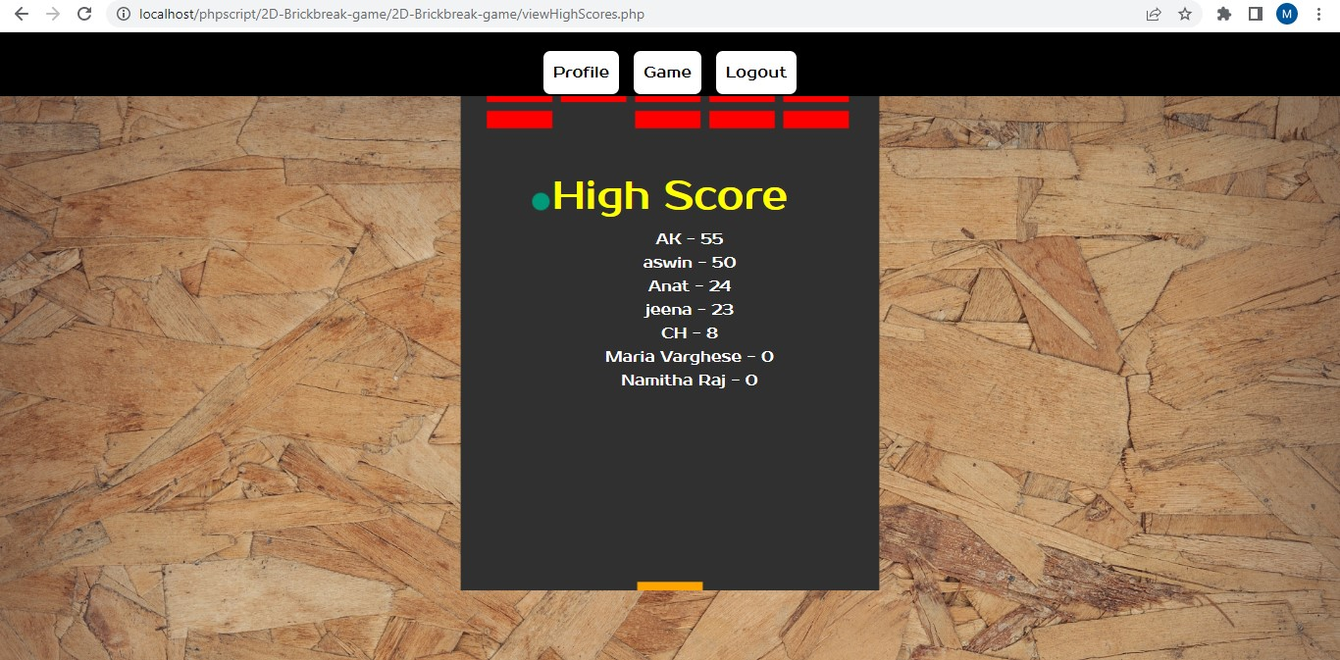
High score page

Slide 10
conclusion
A brick game using HTML, CSS, JAVASCRIPT and PHP is implemented here. HTML, CSS and JAVASCRIPT is used for developing the front end and code for the game is written using JAVASCRIPT.PHP is used for connecting to the database ,for storing the registrations ,scores etc to the database.

